Slide 1
Presentation #2

Slide 2
Agenda
Notes:
Vivian

Slide 3
Google Merchandise Store
Notes:
Vivian

Slide 4
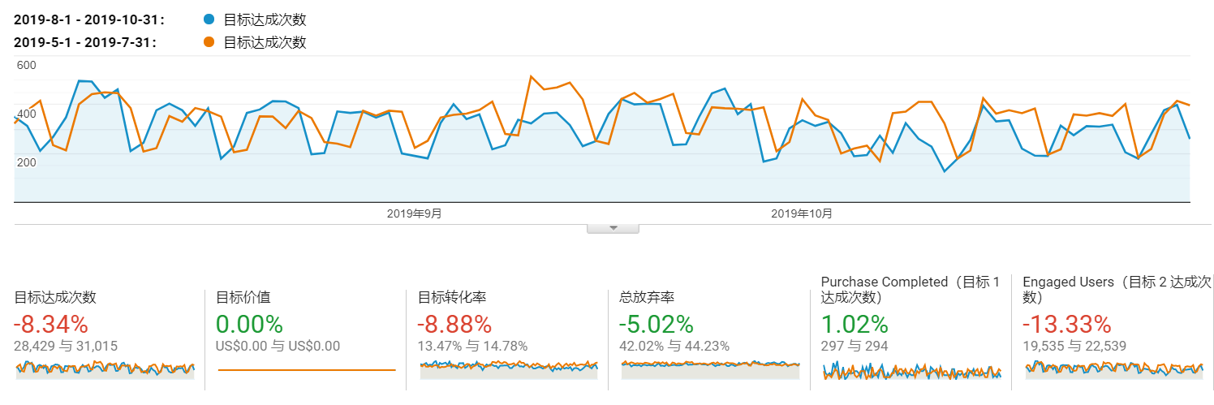
Identified Issue
Our attraction for visiting customers to buy products reduced!
Completed Purchase dropped 8%
Conversion dropped 9%
Notes:
Chengjun: Ok. Let’s identify the issue to improve the performance of google merchandise store. It’s easy for us to know that purchase dropped 8 percent and conversion for visitors to buy products dropped 9 percent in recent 3 months. That’s not good because that means we cannot make our customers determined to buy goods before they leave the store..

Slide 5
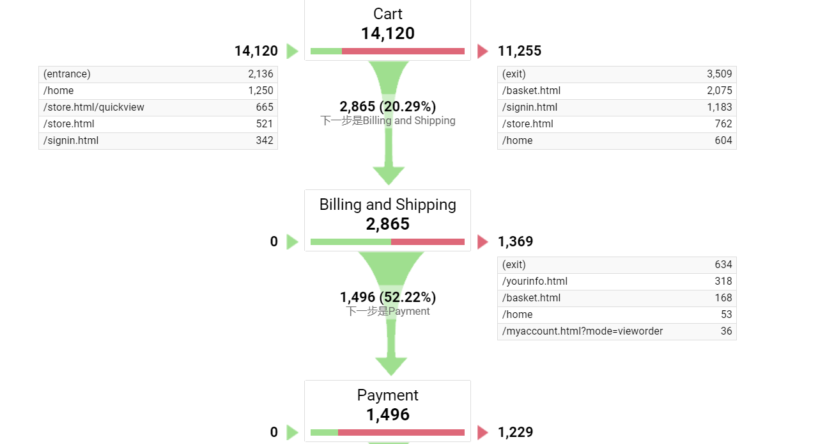
Identified Issue
Customers are less and less from visiting to payment.
Notes:
So how does our purchase drop? As we can see from the funnel graph, we get almost 15000 customers to visit our store from various channels, but most of them leave the store with no interest buying anything, and the half of the remaining customers give up payment even though they intend to buy some products. So although we have so many customers, we only get revenue out of 10% of them .

Slide 6



Identified Issue
Product: No interesting goods?
Why?
Marketing: Store not attractive?
Checkout: Change the mind?
Notes:
That’s not satisfying. We should have got more visitors to buy our products. Why do so many customers leave?

Slide 7

Data Collection Methods
Google Analytics gives us insights of customer behavior data.
Notes:
How do we explore the reasons through data? The most important data analytical tool we rely on is Google Analytics. It offers full-scale data of what happened in the store and built-in analytical charts to give you the insights of customer behavior.

Slide 8
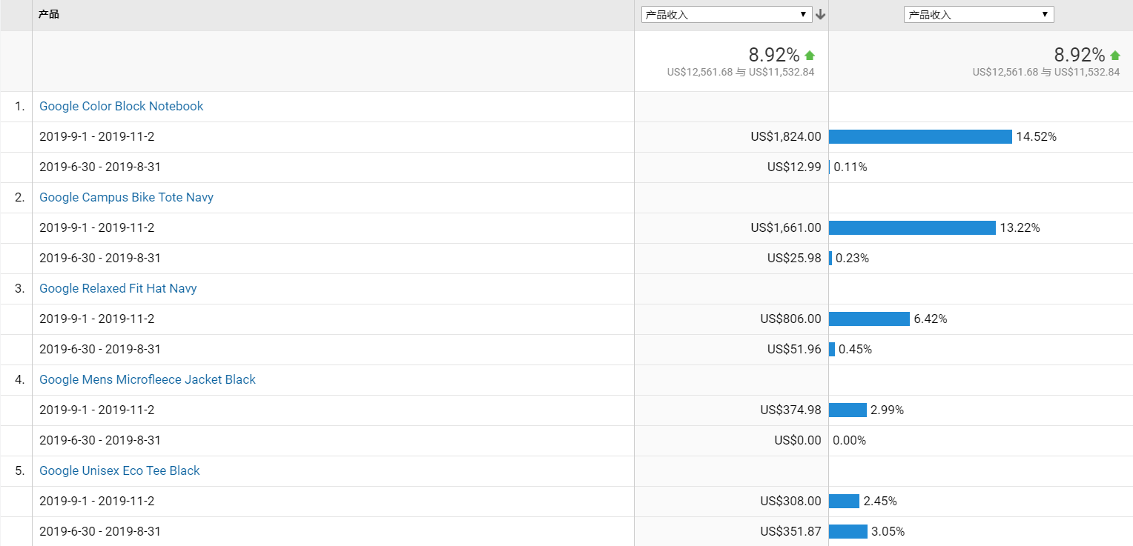
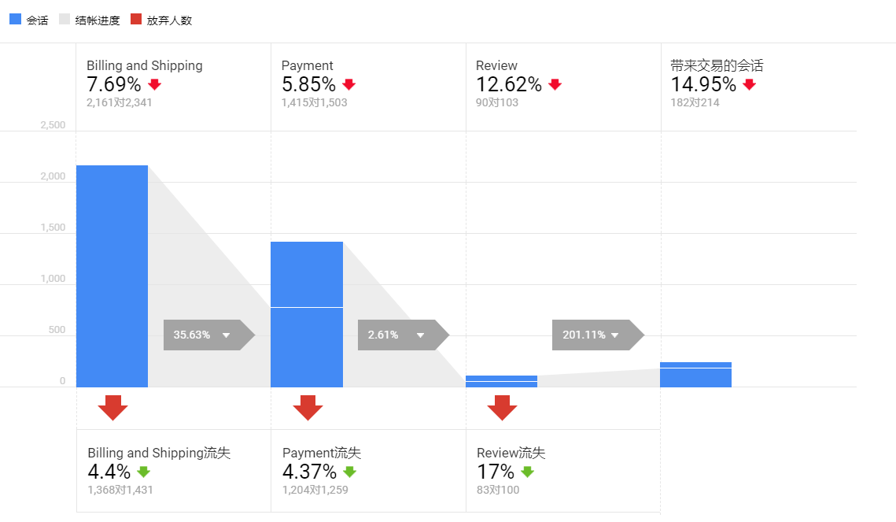
Data Collection Methods
Product Sales
By selecting through analysis list, we can find data of different store sales behavior.
Checkout Data
Notes:
We can select sections we are concerned about like product performance and customers passing checkout to get instant data tables and graphs, so we can easily focus on possible reasons of products, marketing and checkout.

Slide 9
Product - graph
Notes:
Jasleen

Slide 10
Product - Recommendation
Notes:
Jasleen

Slide 11
Marketing - graph
Notes:
Kenneth

Slide 12
Marketing - recommendation
Notes:
Kenneth

Slide 13
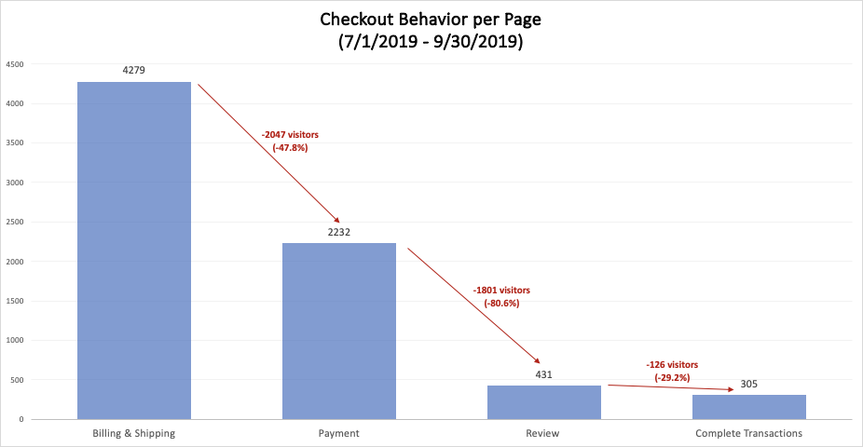
Checkout Behavior - graph
Notes:
Sam

Slide 14
Checkout Behavior - recommendation
Notes:
Sam

Slide 15
Conclusion
Notes:
Vivian

Slide 16
Thank you!
Q&A

Slide 17
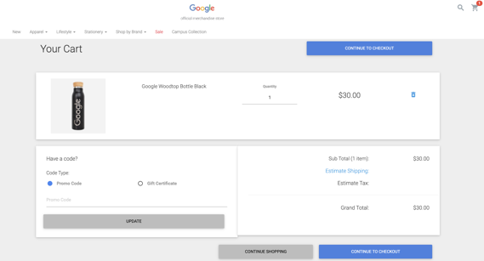
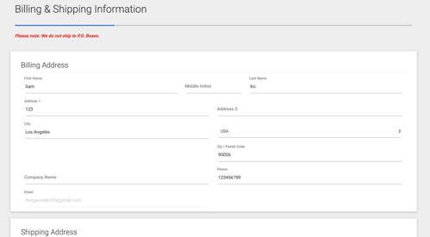
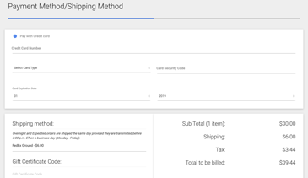
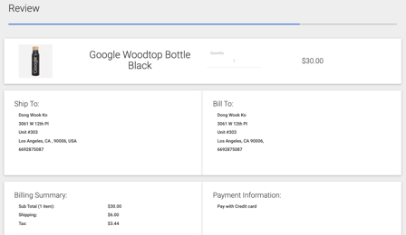
Appendix
Cart
Billing & Shipping
Payment
Review
Notes:
Vivian

